Slide 1


Welcome to Room Planner and Layout Designer Management System
We're here to streamline your room planning and layout design projects, providing a professional, organized, and efficient platform to meet your needs. Our system is tailored for interior designers, architects, and project managers in the field, offering comprehensive tools and expert support. Get ready to elevate your design process.

Slide 2
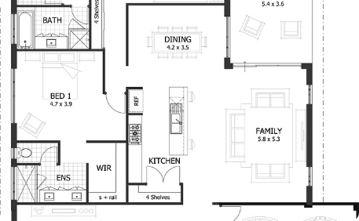
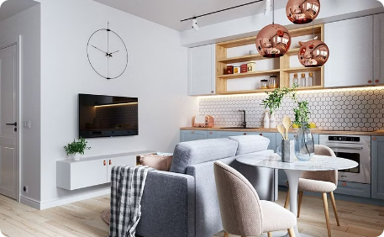
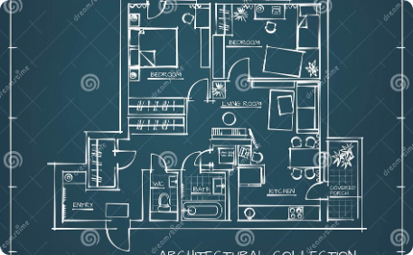
Basic Principles of Room Planning
Functionality
Balance and Scale
Flow and Circulation
Understand the importance of space optimization and how to create practical layouts that maximize functionality.
Learn how to achieve visual balance and scale in room layouts, ensuring a harmonious and coherent design.
Discover strategies for enhancing flow and circulation within interior spaces for a seamless design experience.

Slide 3

The Impact of Lighting
1
Natural Lighting
2
Artificial Lighting
Understanding the effects of natural light and its influence on color, texture, and the overall ambiance of a space.
Exploring the role of layering different types of lighting to create mood, highlight features, and ensure functionality.
3
Control Systems
How to integrate smart lighting control systems to enhance flexibility and efficiency in various room settings.

Slide 4
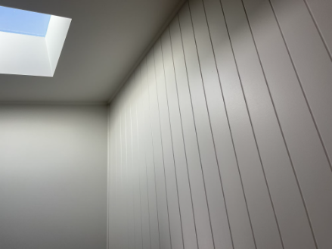

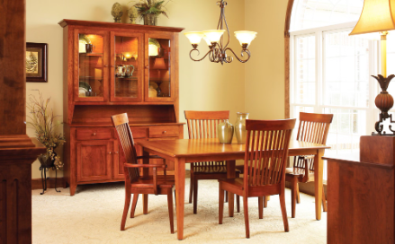
Materials and Finishes Selection
Floors
Walls
Furnishings
Exploring various flooring materials and their impact on aesthetics, durability, and maintenance in different spaces.
Understanding the visual, tactile, and acoustic properties of different wall finishes to achieve desired atmospheres.
Insights into selecting furniture materials and finishes that complement a design concept while meeting functional requirements.

Slide 5

Efficient Space Utilization
1
Multi-Functional Zones
Strategic approaches to creating multipurpose zones within a given space without compromising design quality.
2
Storage Solutions
How to integrate innovative storage solutions seamlessly into room designs while maintaining aesthetic appeal.
3
Flexible Furnishing
Understanding how adaptable and versatile furnishings can maximize usability and adapt to evolving needs.

Slide 6

Color Palettes and Schemes
Psychological Impact
Harmonious Combinations
Accent Colors
How to use accent colors strategically to enhance focal points and add visual interest to a room design.
Understanding how different colors can evoke emotions, influence moods, and shape perceptions within spaces.
Insights into creating cohesive color palettes and combinations to achieve desired atmospheres and aesthetics.

Slide 7



Incorporating Technology
Smart Home Integration
Virtual Reality Visualization
Energy-Efficient Solutions
Explore seamless integration of smart home technology for convenient control and enhanced functionality.
Understanding how VR technology can revolutionize the visualization and presentation of room designs.
Insights into incorporating energy-efficient systems and sustainable practices within room designs.

Slide 8




Project Management Best Practices
Conceptualization
Strategies for developing clear design concepts and translating them into actionable project plans.
Collaboration
Effective communication and collaboration strategies among team members, clients, and stakeholders.
Quality Control
Implementing robust quality control measures to ensure the successful execution of room design projects.
Documentation
Guidelines for maintaining comprehensive project documentation to track progress and ensure accountability.

